Slide 1
Lecture 10
Consolidation and Coursework briefing

Slide 2
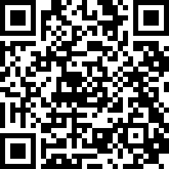
Outline
Coursework Briefing
  Go through each task
  What to be submitted
  When and where to submit
Questions and Answers
Please scan the QR code to do module evaluation.

Slide 3
Task 1: Team Organisation and Project Management (Team Part)
Include the following contents in the teamwork report
  Team collaboration mechanisms and facilities
    GitHub Repository of the team’s project
      URL
      A list of folders and explanation of the contents of the files in the folder
      What should be stored in the repository
        Team operation documents: meeting agendas, meeting minutes, etc.
        Papyrus model files for each subsystem
        Papyrus model files for the integrated architectural design of the whole system
  Team operation summary
    A table to list all team meetings
      Date, Venue, Start time, Finish time, Topics, Meeting chairperson, Attendance, Agenda URL, Minutes URL
    A statement on team collaboration, e.g. which documents were cross checked by whom or at which group meeting
See Slide 25

Slide 4
Task 1: Team Organisation and Project Management (Individual Part)
Each student to include the following contents in the Individual Report as a section on personal reflection of the teamwork
  Contribution to team organisation
    Attendance to team meeting
    Chairing team meetings, preparing agenda, recording meeting minutes
    Setting up GitHub repository, etc.
  Technical Contributions
    Completion of tasks on time, frequency of committing work to GitHub repository
    Cross checking and comments on other person’s work
See Slide 26

Slide 5
Task 2: Analyse and Specify Quality Reqs
Each student to write a specification of quality requirements on the selected subsystem
  Select one required function of your subsystem, define the quality requirements on the following quality attributes:
    Security and Privacy protection, Performance, Reliability, Scalability
  What is a good work:
    Correct for the quality attribute (Not need to give a definition or explanation of the quality attribute)
    Clarity of the statements on quality requirements
    Statements must be testable and verifiable
    Completely cover all quality attributes
    Reasonably accurate w.r.t. the reality

Slide 6
Task 3: Modelling SW Functional Reqs
Task 3(a) Use case diagram
  Each student develop a use case diagram for the selected subsystem
  What is a good work?
    Use the UML modelling tool Papyrus
    No syntax error
    Cover all functional requirements
    Logically correct
      Correct actors, subject, and use cases
      Correct relationship between the actor and the use cases
      Correct relationships between use cases
    Use cases at the right level of abstraction
      Not too high level (a use case has very complicated interactions and should be decomposed)
      Not too low level (a use case has very simple and short interactions)

Slide 7
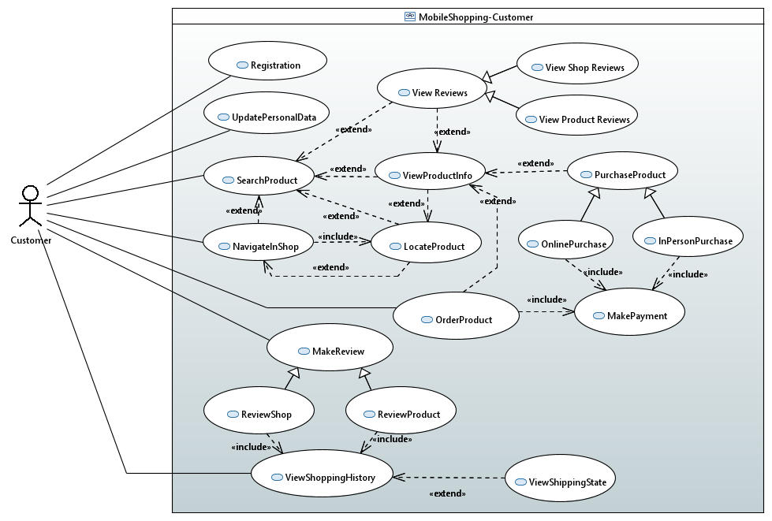
Example: CloudShop-Customer Subsystem
Use case diagram

Slide 8
Relations between Use Cases
A include B:
  A is the base use case
  Without B, A is not complete => B is essential
B extend A:
  A is the base use case
  A is independently meaningful => B is not essential
A generalise B:
  B is a subset of the interaction sequences of A

Slide 9
How to Build a Use Case Model
Start with identification of Base Use Cases
  The true use cases that the user has a clearly defined usage purpose
Decompose a use case, if it is too complicated or can be made modular
  Use include relation:
    Two or more use cases have a common part
  Use extend relation:
    The interactions of a use case have repeated and optional sub-sequences of interactions
  Use sub-use case relation:
    The purpose of usage can be specialised into a few more specific ones
    The set of interactions can be devised into a few subsets
Stop decomposition if the complexity of the interactions of the use case are manageable
  A use case is unnecessary if the interaction is only a couple of steps.
Use cases should be at the right level of abstraction.

Slide 10
Task 3(b) Activity diagram
  Each student develop an activity diagram for one use case of the selected subsystem
  What is a good work?
    Use the UML modelling tool Papyrus
    Model the interactions between a user and the subsystem
      Two swimlanes (also called partitions); one for the user and one for the subsystem
      Object flows between the user and the subsystem
    No syntax error
      Decision node and guard conditions, fork and join nodes
    Logically correct
      Consistent with the functional requirements and use case diagram
      Correct sequence of interactions and the data passed between the parties
      Correct guard conditions
    Right level of abstraction
      Each step of the interaction is feasible to perform

Slide 11
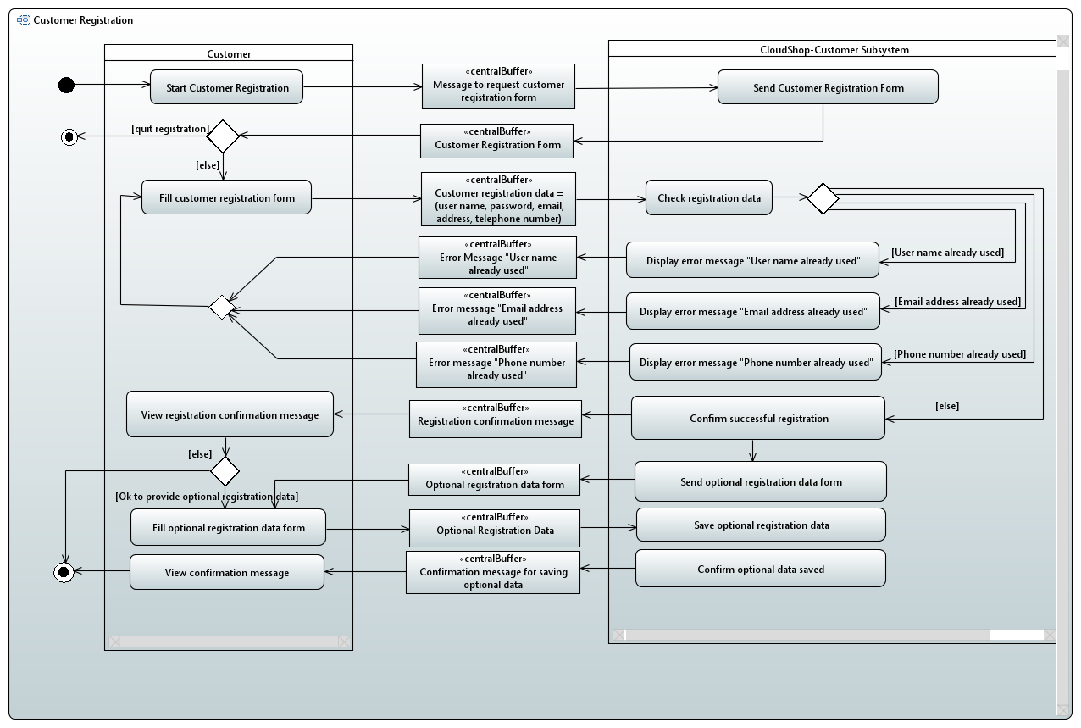
Example: CloudShop-Customer Subsystem
Activity diagram for the Registration use case of the Customer subsystem

Slide 12
Task 4(a): Architectural Design of Subsystem
Each student make one architectural design for the selected subsystem
  In UML component diagram
  Use the modelling tool Papyrus
  Comply to the microservices architectural style
What is a good work?
  Consistency with the functional requirements
  Consistency with the overall structure of the whole system
  Correct in syntax and semantics
  Clarity of the specification in a text document
    Functionality of each component and interface
    Meanings of the functions and parameters

Slide 13
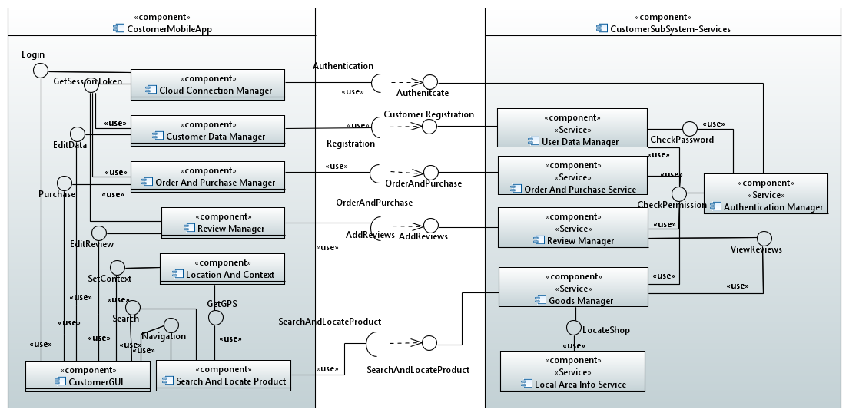
Case Study: Mobile Shopping System
Architectural Design of Customer Subsystem (Revised)

Slide 14
Specification of Microservices
Example:
Component | Review Manager
Description | This is a microservice running on the Cloud to process customer’s reviews on products and shops.
Stereo Type | Service
Required Interfaces | CheckPermission
Provided Interfaces | AddReview, ViewReview

Slide 15
Specification of Interfaces
Name | Authenticate
Provider | Authentication Manager
Operation | Signature | customerLogin(user_Id:String, password:String, ip_Address: IP_Address): accessToken: String
 | Function | Check if the customer’s password matches the stored password. If yes, login is successful and returns an accessToken; Otherwise, login fails and returns an error message. The accessToken is a string that contains data of the customer_Id, an ip address and the user type (“customer”) in an encrypted format. It will be used to check if an access to a piece of data is permitted after decrypting it.
Operation | Signature | managerLogin(user_Id: String, password:String, ip_Address:Ip_Address): accessCode: String
 | Function | Check if the password matches the store password of the user. If yes, login is successful and returns an accessCode; otherwise, login fails and returns an error message.

Slide 16
Task 4(b): Integration of subsystems
Each group produces one component diagram that contains all components and the interfaces between them to be on the cloud from all subsystems.
  Contain all components from all subsystems to be run on the cloud
  Components/interfaces from different subsystems of the same or similar functionality could be merged into one
  Components/interfaces of the same name but of different functionalities should be renamed to avoid naming conflictions
Each member of the group to revise the architectural design of the subsystem according to the results of integration

Slide 17
Integration of Subsystems: Example
Example: Authentication components
Every subsystem has a component for managing the authentications of users and controlling access to data
These authentication manager components may be different
    Different types of users should be given different access tokens
    Different functions for check permissions for different types of users
    Different interfaces to connect to the components in different subsystems

Slide 18
Possible Solutions
For Components
Solution 1:
  Merge all authentication components into one
  Revise the specification of the component
Solution 2:
  Keep all authentication components separate
  Rename them to different names, e.g. Customer Authentication Manager, Staff Authentication Manager, etc.
For interfaces
Solution 1:
  Merge different interfaces into one
  Reconnect it to the other components
Solution 2:
  Keep interfaces separate
  Rename interfaces if names conflict with each other, e.g. customer login, staff login, etc.

Slide 19
Task 5 Detailed Design
Task 5(a) Structural Design of Microservices
  Select one microservice in your architectural design of the subsystem
  Draw a class diagram to model how to implement the selected microservice from structural point of view
    Attributes and their types, visibility
    Methods, the parameters and their types, visibility
    Relations:
      Associate, whole-part, inheritance
      Multiplicity, names
  What is a good work?
    Correct: syntax and semantics
    Complete: contains all classes, attributes and methods needed
    Non-trivial: select a component that is not too simple
Use the UML modelling tool Papyrus

Slide 20
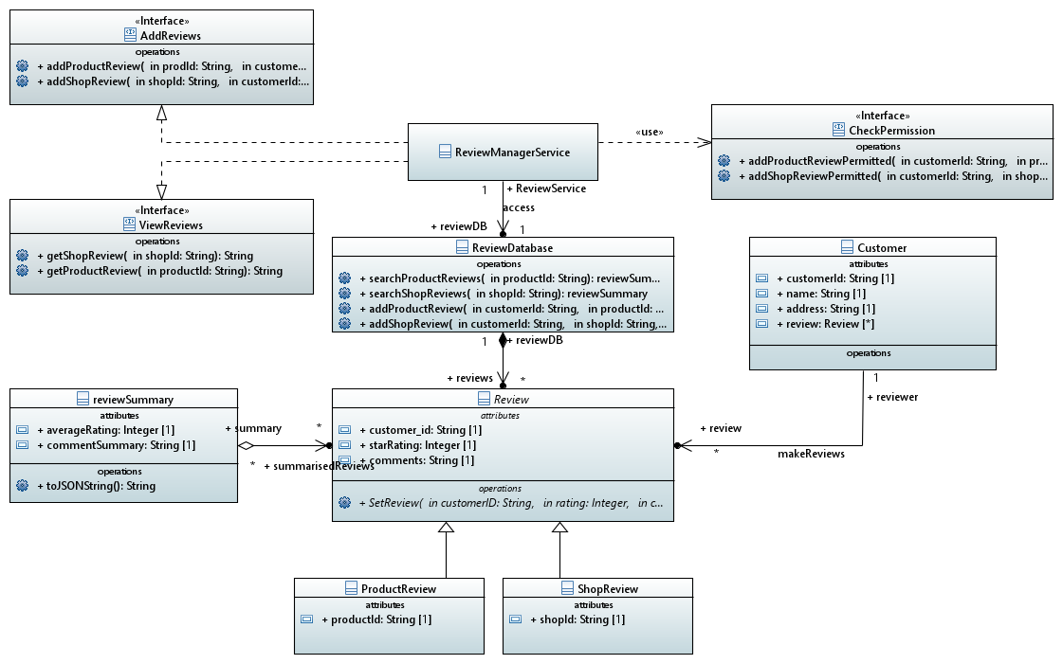
Detailed Design: Example: The Review Manager
Structural Design (Class Diagram)
Interfaces required by the microservice
Interfaces provided by the microservice

Slide 21
Task 5 Detailed Design
Task 5(b) Behaviour Design of Microservices
  Use the same selected one microservice in your work on Task 5(a)
  Draw a sequence diagram to model how to implement the selected microservice from behaviour point of view
    Lifelines: the heads should be classes in the class diagram (including interfaces provided and required)
    Fragments (also called frames in old versions of UML): must be used to model different sequences of interactions between objects of different types
    Messages:
      Labels must match the signature of a method of the receiving object
      Arrows must correct to represent the right type: synchronous, asynchronous, reply, found, lost, object creation and object destruction
      Orders and the uses of fragments must be semantically correct

Slide 22
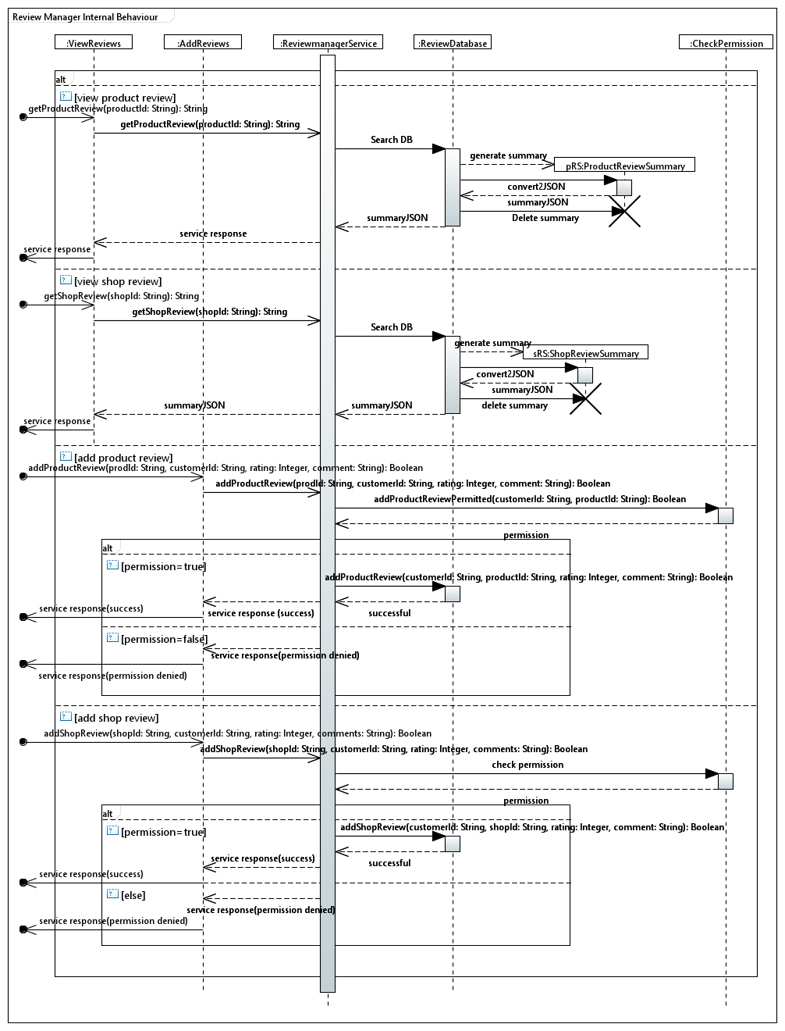
Detailed Design: Review Manager Component
Dynamic behaviour
(sequence diagram)
Four parts of Alt fragments, one for each type of service requests:
View product reviews
View shop reviews
Add a product review
Add a shop review

Slide 23
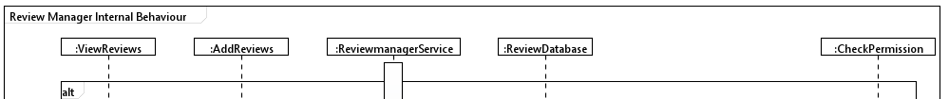
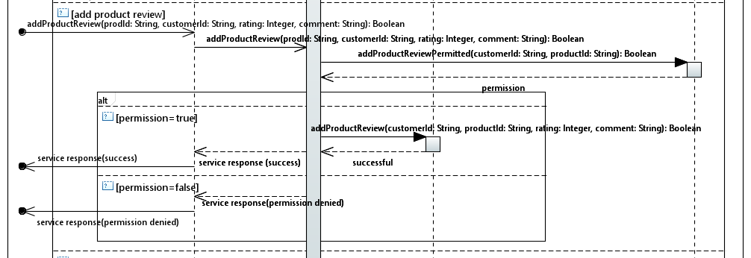
Detailed Design: Review Manager Component
Fragment for adding a product review

Slide 24
What To Be Submitted
Gxx is your coursework group number
One zip file from each group containing the following files
File name | Format | Content
COMP5047_CW_ Gxx.zip | Zip file | The zip file that contains all the files of the group’s coursework submission
Cover_Gxx.pdf | PDF | Group coursework cover page
TeamPart_Gxx.pdf | PDF | See next slide
Member_Gxx_StdNum1.pdf | PDF | Work of student 1900002; See slide 26
Member_Gxx_StdNum2.pdf | PDF | Same as above
Member_Gxx_StdNum3.pdf | PDF | Same as above
Member_Gxx_StdNum4.pdf | PDF | Same as above

Slide 25
Outline of Team Report
1. Team organisation
  A list (or a table) of team members
  Give names and student numbers with the name of the subsystem developed
  Indicate who is the team leader
2. Team collaboration mechanisms and facilities
  See Slide 3 for the contents to be included
3. Team operation summary
  See Slide 3 for the contents to be included
4. Architectural design of the system
  A component diagram for the components running on the cloud and the interfaces provided

Slide 26
Outline of Individual’s Report
1. Specification of Quality Requirements
2. Software Functional Modelling
  2.1. Use case model
  2.2. Activity model
3. Software architectural Design
  3.1. Architecture of the subsystem
  3.2. Specification of the components and interfaces
4. Detailed Design
  4.1. Structural model
  4.2. Behavioural model
5. Reflection on Teamwork
  5.1. Contributions to teak organisation and project management
  5.2. Technical contributions
Please make it clear which subsystem you r are developing.

Slide 27
When And Where To Submit?
Deadline of submission:
  23:00pm on 5th Dec. 2025 (Friday of Week 11)
  No late submission is allowed
Where to submit:
  Upload the zip file to Moodle
  Must be done by the team leader
  Do not submit twice
  No submission by email is allowed

Slide 28
Coursework Assessment Arrangement
Group | Assessor | Email
Group 1 – 11 | Abishaan Ravikumar | 19232440@brookes.ac.uk
Group 12 – 13, Group 20 – 29 | Hong Zhu | hzhu@brookes.ac.uk
Group 13, Group 30 – 39 | Rachel Harrison | rachel.harrison@brookes.ac.uk
Group 14 – 15, Group 41 – 49 | Yana Krytska | ykrytska@brookes.ac.uk

Slide 29
Access to GitHub Repository for Marking
Grant your coursework assessor and me the access to your group coursework’s GitHub repository via an invitation from the GitHub website.

Slide 30
Questions and Answers
What if a member of the group is granted an extension?
  The student granted extension must email me in advance
    State your intension of use the extension
    State your entitled extension length
    Gives your group number
  The team can submit the coursework by the extended deadline
    No need to submit twice
    The zip file must be uploaded to Moodle by the student who is granted the extension
    The team leader must check if the uploaded file and its contents are correct
Email Address: hzhu@brookes.ac.uk

Slide 31
Questions and Answers
What if a member of the group is not performing as expected?
  Give the facts in the team report
  Marking will take the facts into account
What if one of the group member drops off from the module?
  The group should do three subsystems; each student still only do one subsystem
  Marking will not affect the remaining students

